Slide 1
Reaching PCI Nirvana: Ensure a Successful Audit and Maintain Continuous Compliance

Slide 2
Topics Covered
What you need to know about the upcoming PCI-DSS version 3.2
How to ensure your network is compliant now, and maintains continuous compliance
Identifying the latest vulnerabilities and assessing risk before the auditor does
How to reduce the scope of your audit, and instantly generate audit-ready reports
PCI and the cloud

Slide 3
SSL and Early TLS
The cryptography behind https://server.name.here
2014, 2015: run of attacks against SSL 2.0, 3.0. and TLS 1.0
“Heartbleed”, “FREAK”, “POODLE”, “Logjam” …
→ Industry consensus: SSL (all versions), TLS 1.0 “broken beyond repair”

Slide 4
PCI response
PCI-DSS 3.1 (April 2015):
“SSL and early TLS are not considered strong cryptography”..“cannot be used as a security control after June 30, 2016”

Slide 5
Switch to TLS 1.1 / 1.2 ?
All modern browsers have supported TLS 1.2 for several years:
Chrome - v30
Firefox - v27
Internet Explorer - v11
Opera - v17
Safari - v5 on iOS, v7 on OS X
All modern libraries and web-server platforms support TLS 1.2 for several years
……So switching to TLS 1.2 is easy, right?

Slide 6
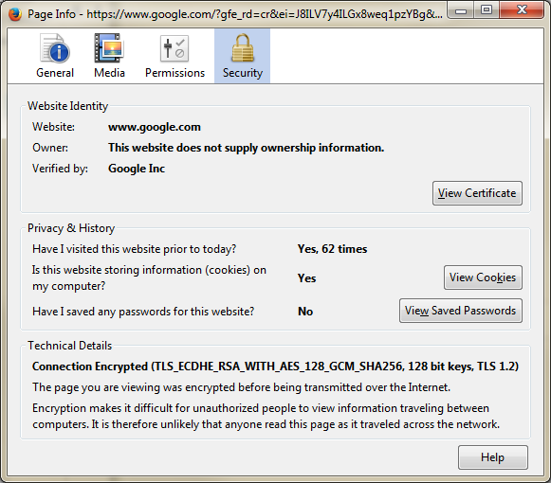
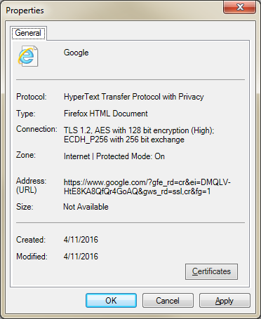
examples
Firefox 45
Internet Explorer 11

Slide 7
check the middleware
TLS is not only used by browsers and web servers:
Machine-to-machine web-service API communication
SOAP / REST / etc.
Web-page “scraping” utilities
Automatic testing platforms
E-Mail servers and E-mail clients
Embedded web-servers inside devices
May need to be upgraded to a TLS-1.2-compatible version
→ Bottom line: Switch to TLS 1.2 requires testing – and time

Slide 8
Coming up in PCI 3.2
PCI-DSS 3.2 scheduled for publication at the end of April
draft already available to members
PCI-DSS 3.1 will be retired Oct 2016
Extending the migration [to TLS 1.1/1.2] date to 30 June 2018
Don’t Wait!

Slide 9
What else is in PCI 3.2?
From PCI blog:
“PCI DSS is a mature standard now” “doesn’t require as significant updates as we have seen in the past” (PCI Blog)
From PCI-DSS 3.2 draft:
New appendix A.1 for hosting providers
Deadline for TLS 1.1/1.2 offering: 30 June 2016
New appendix A.2 focusing on SSL/TLS
Other minor changes

Slide 10
Common PCI-DSS Compliance Challenges

Slide 11
Manual Audits Slow Down Business and are Error-Prone
Time devoted to firewall audits each year

Slide 12
Compliance Must be Continuous
Assess
Remediate
Report

Slide 13
PCI-DSS Compliance With AlgoSec

Slide 14
Manage Security at the Speed of Business
AlgoSec simplifies, automates and orchestrates security policy management to accelerate application delivery while ensuring security and compliance.
Notes:
AlgoSec simplifies, automates and orchestrates security policy management to enable you to
We believe the only solution lies in –
Simplifying complexity so that lesser skilled engineers can carry out more tasks
Automating tasks as much as you can to free up time
Orchestrating security across the different teams (security, networking etc.) and also heterogeneous environments with multiple vendors and technologies (cloud, SDN, on-premise etc.)

Slide 15
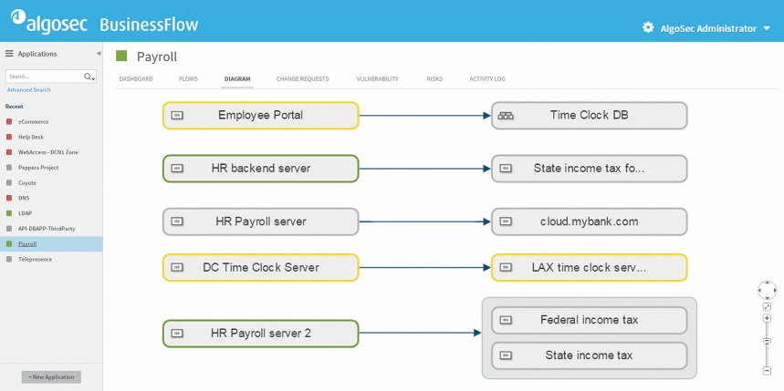
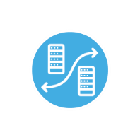
KEY CAPABILITIES
Secure Business Application Connectivity
Security Policy Change Management
NGFW and Datacenter Migration
Hybrid Cloud Security
Security Policy Risk Mitigation
Continuous Compliance and Auditing
Firewall Policy Optimization

Slide 16
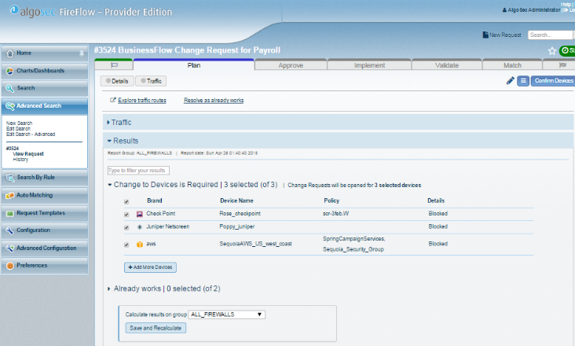
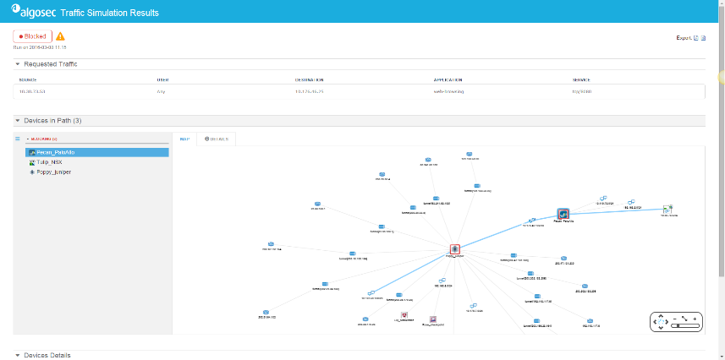
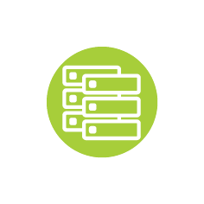
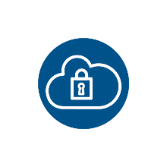
THE ALGOSEC SECURITY POLICY MANAGEMENT SUITE
Application Connectivity Management
Security Policy Change Automation
Security Policy and Network Analysis
Abstraction Layer
Physical Networks
Private Cloud/SDN
Public Cloud
Firewalls
Security Groups
Routers
Web Proxies
Vulnerability Scanners
Load Balancers

Slide 17
Demonstration of PCI Compliance with the AlgoSec Suite

Slide 18
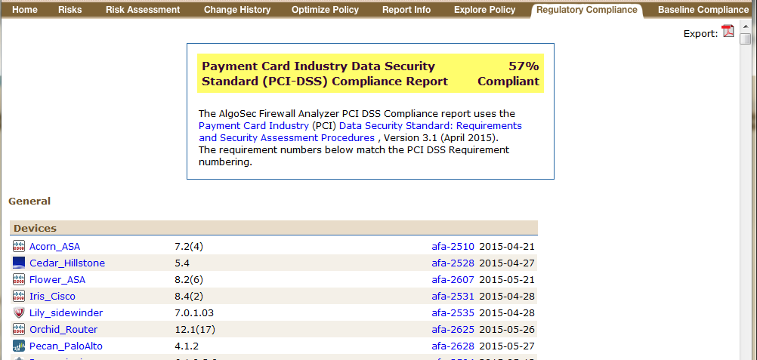
Continuous Compliance

Slide 19
Continuous Compliance
Out-of-the-box PCI v3.1
Support for v3.2 when PCI-DSS 3.2 is released

Slide 20
Continuous Compliance
Exportable

Slide 21
Continuous Compliance
Automatically created
Scheduled or on demand
Covers all AlgoSec-managed devices

Slide 22
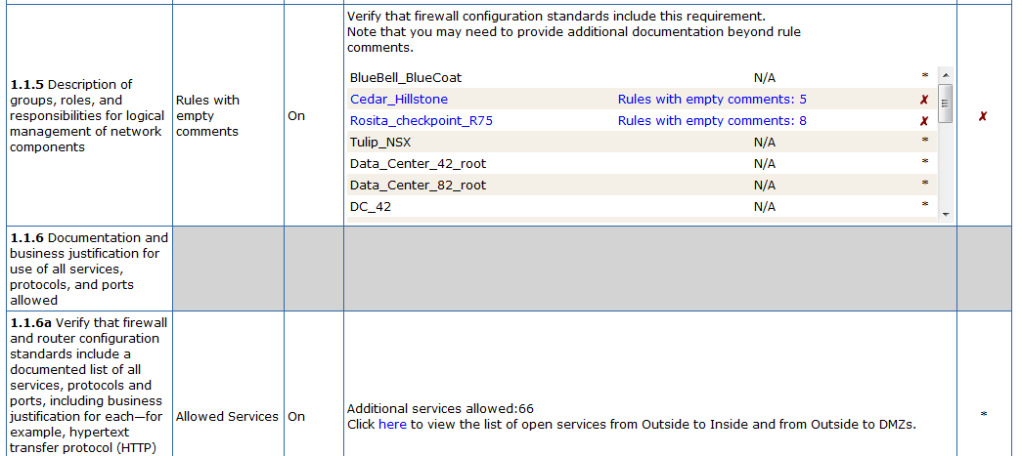
Item-by-Item device collation

Slide 23
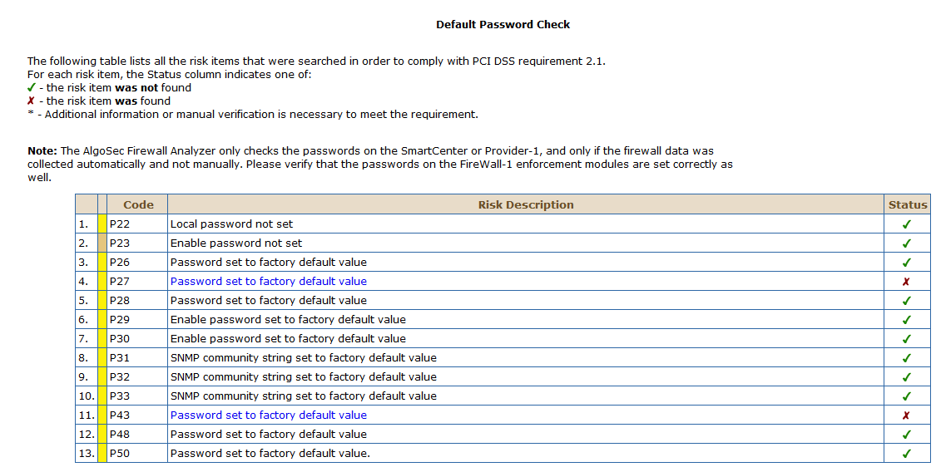
Password Defaults

Slide 24
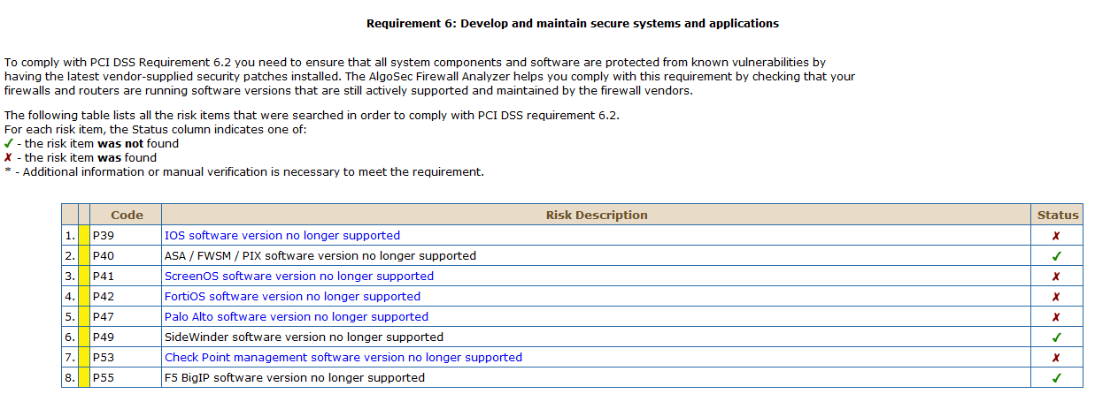
Outdated Software Versions

Slide 25
Baseline Compliance

Slide 26
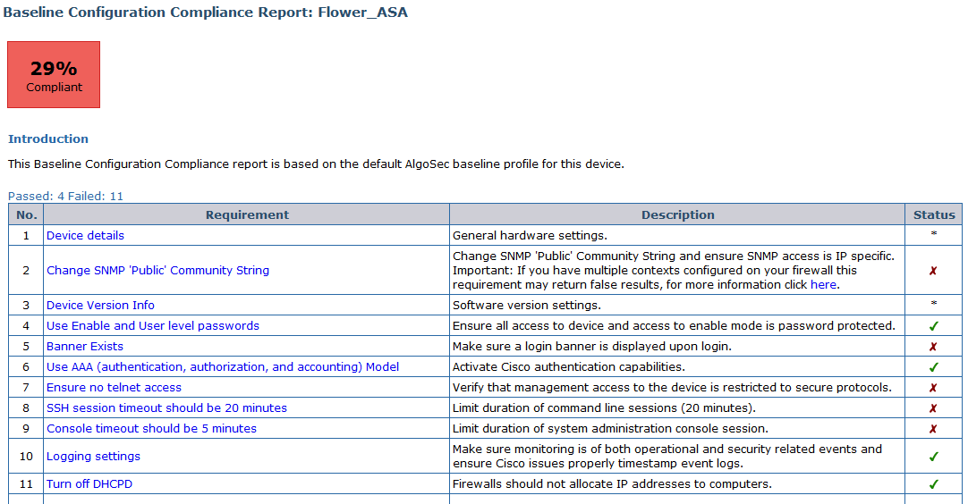
Baseline Compliance
Use AlgoSec Baselines
Or Customize your own

Slide 27
Change Process
AlgoSec provides an application-aware workflow system for network security change management
AlgoSec PCI group compliance reports on how the AlgoSec system is configured

Slide 28
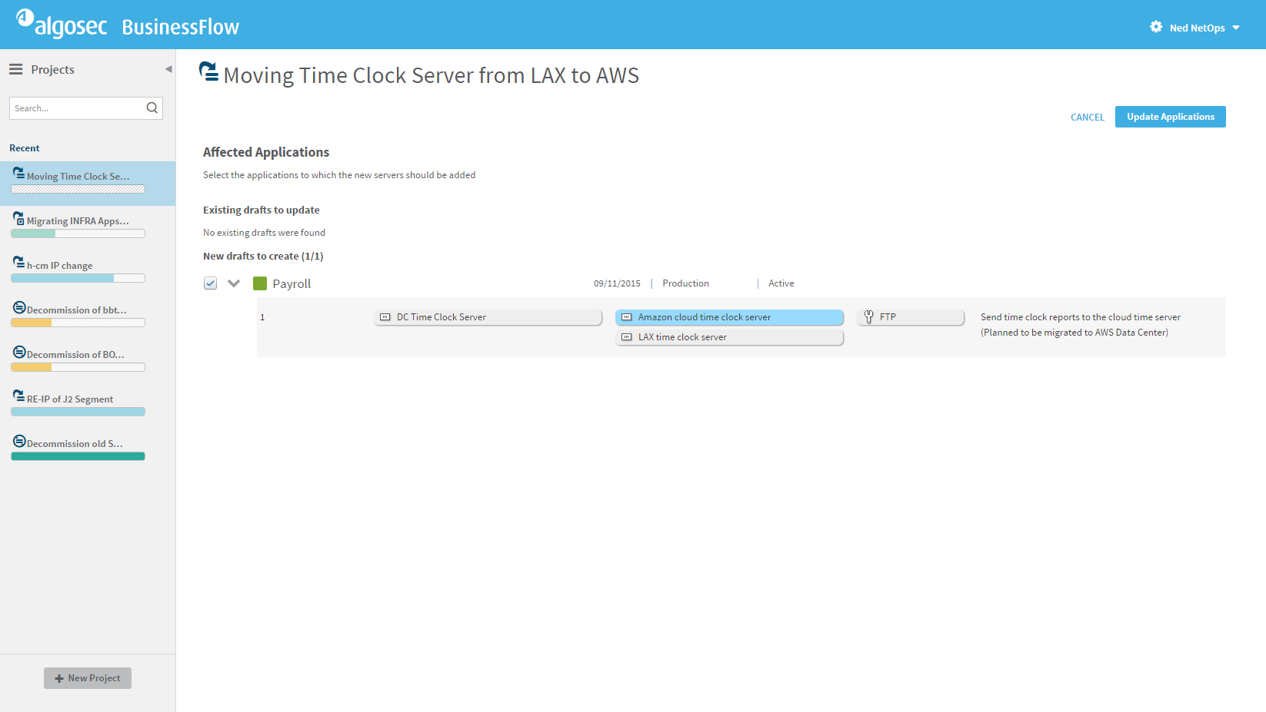

Slide 29
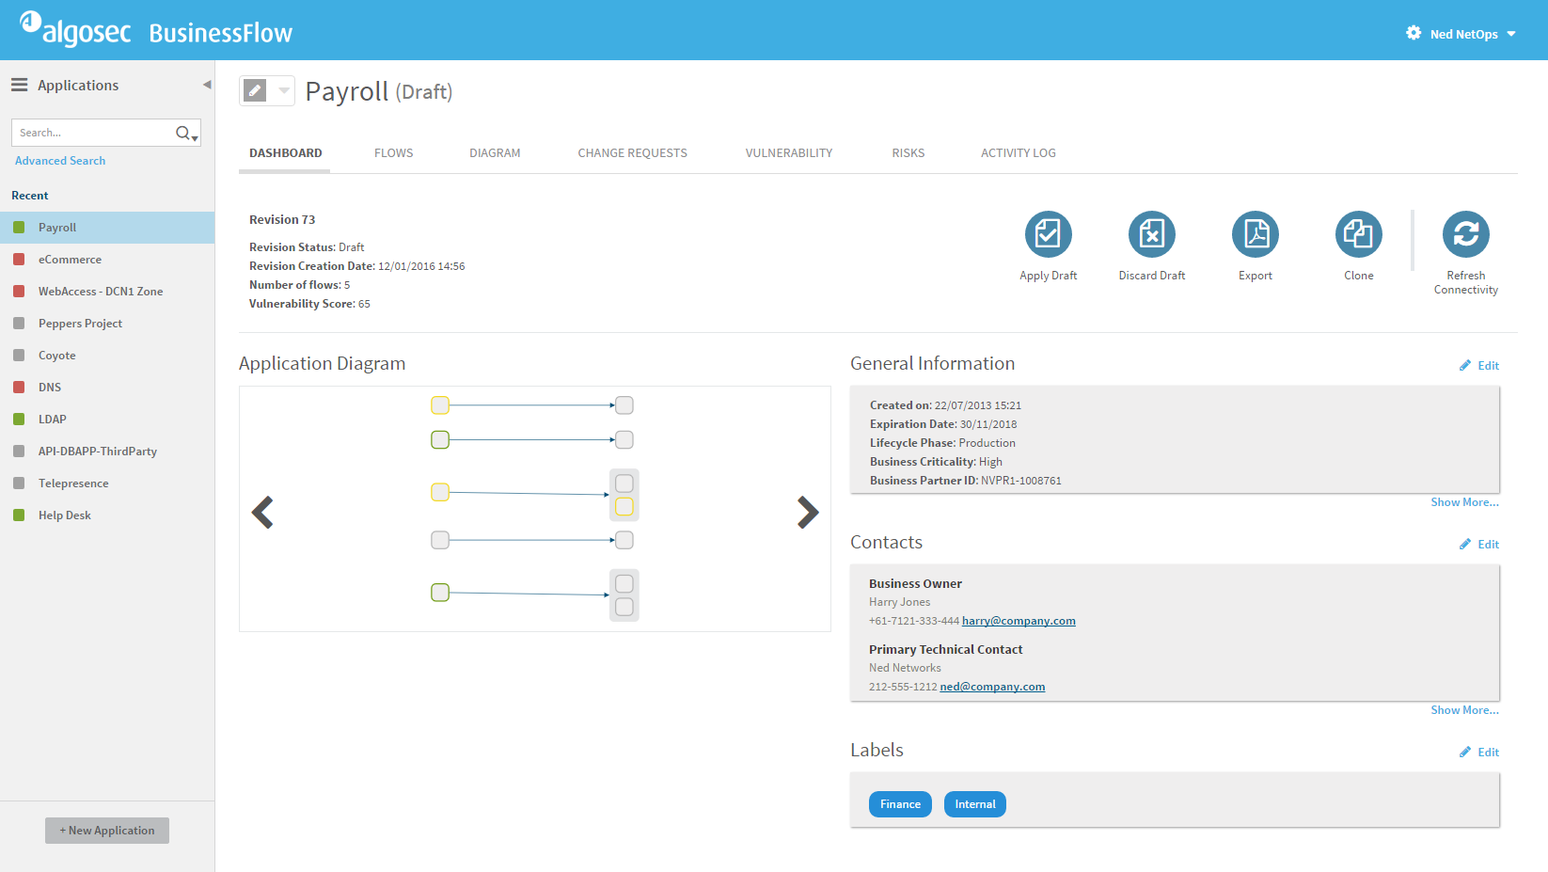

Slide 30
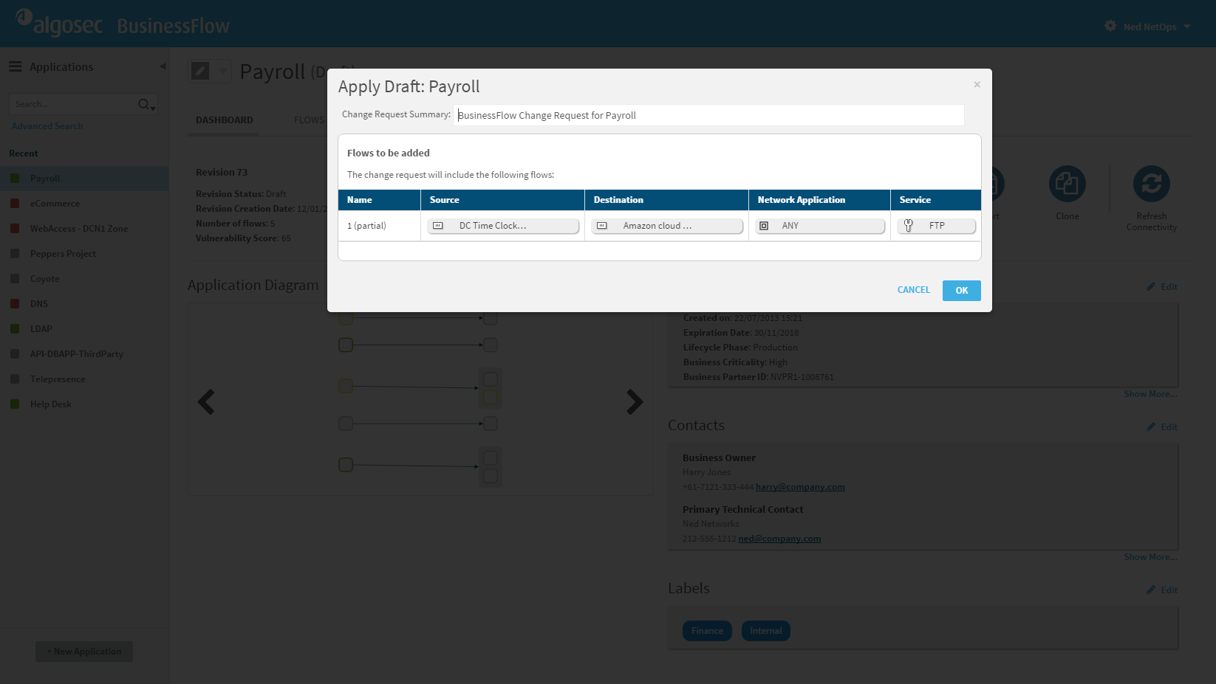
Notes:
[Click OK]

Slide 31
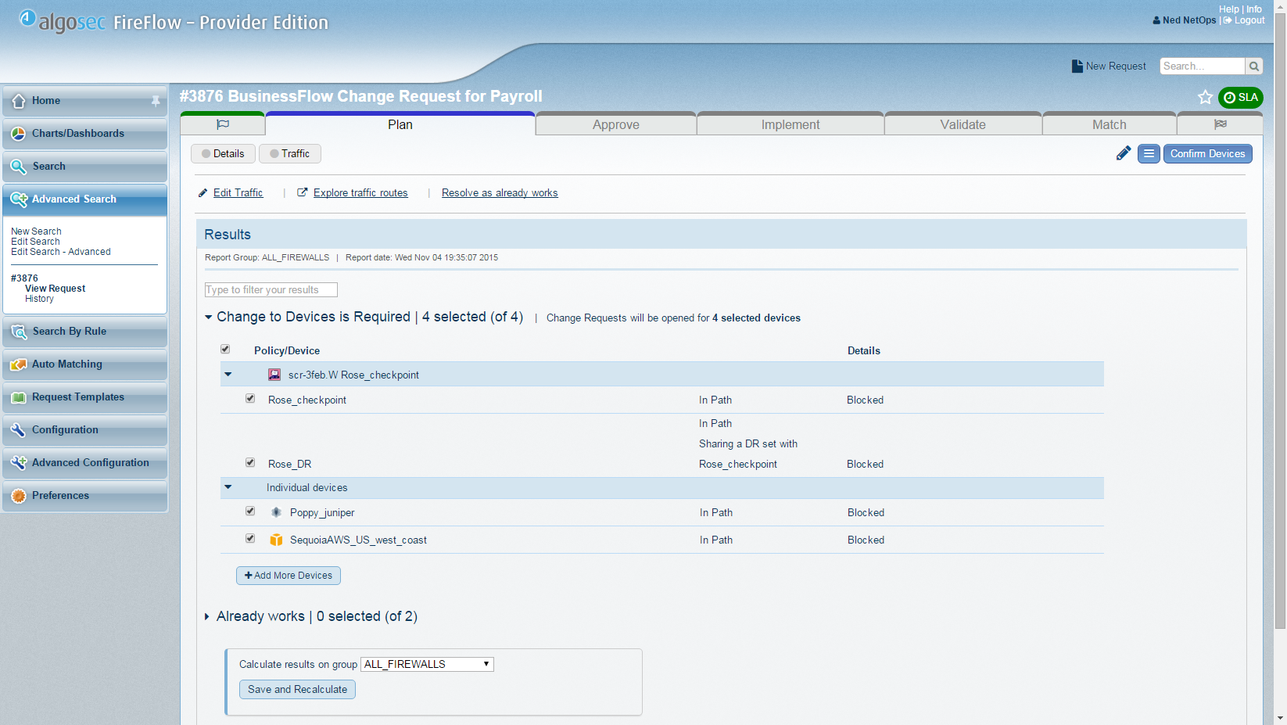

Slide 32
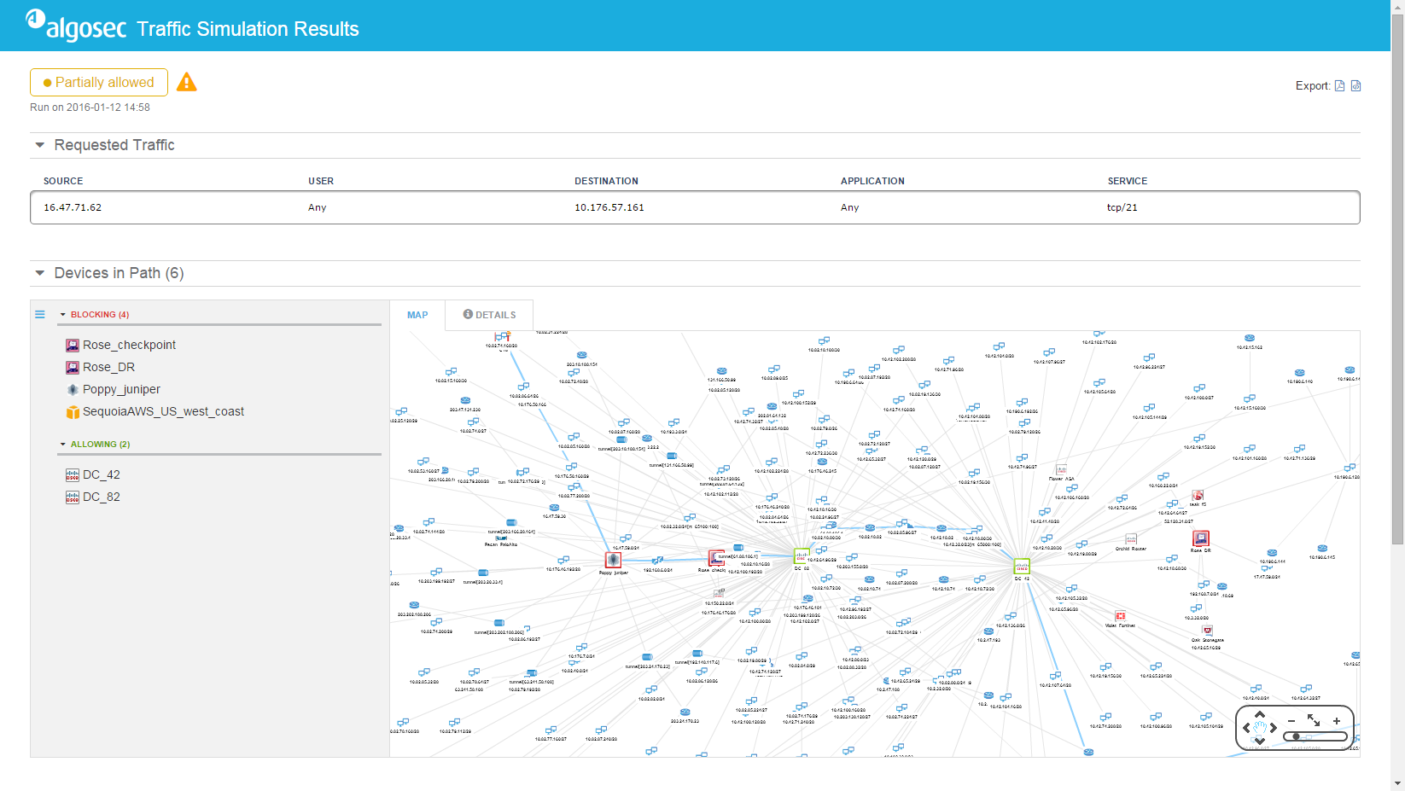

Slide 33
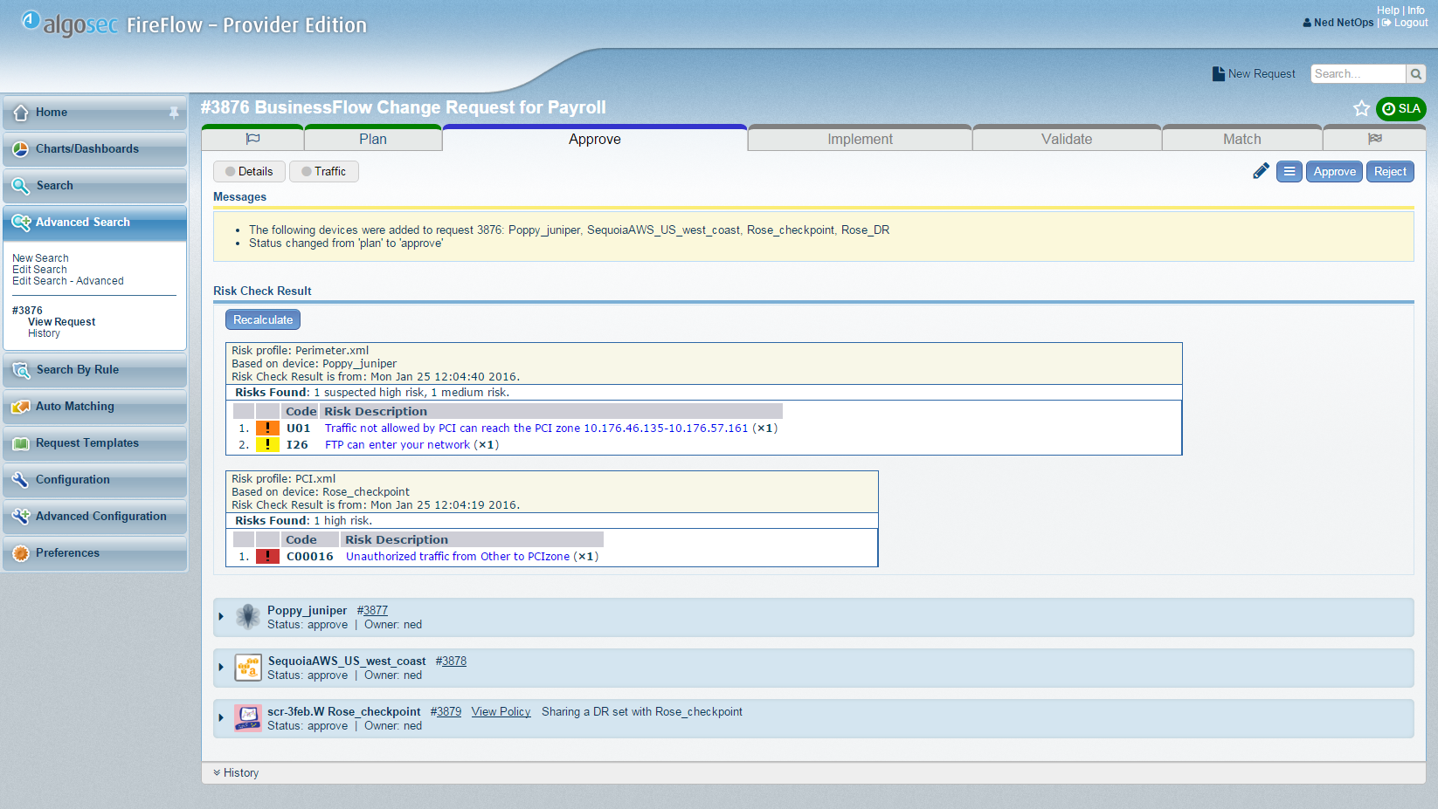

Slide 34
What-if risk check, before changes are implemented

Slide 35
AlgoSec Standard risks +
User-defined risks +
Connectivity spreadsheet violations

Slide 36
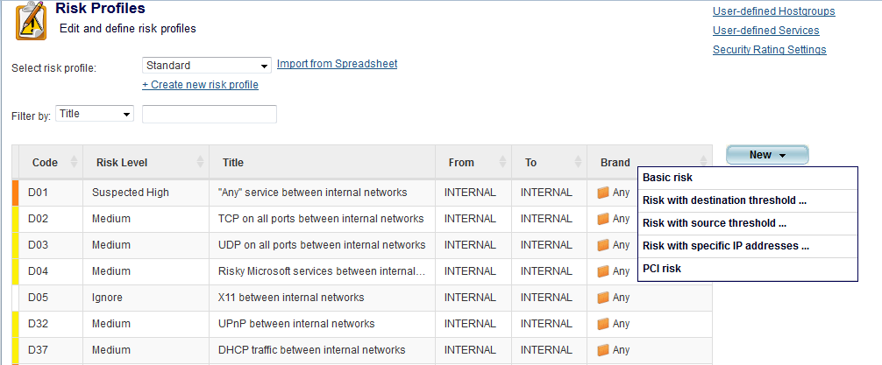
Creating custom risks

Slide 37
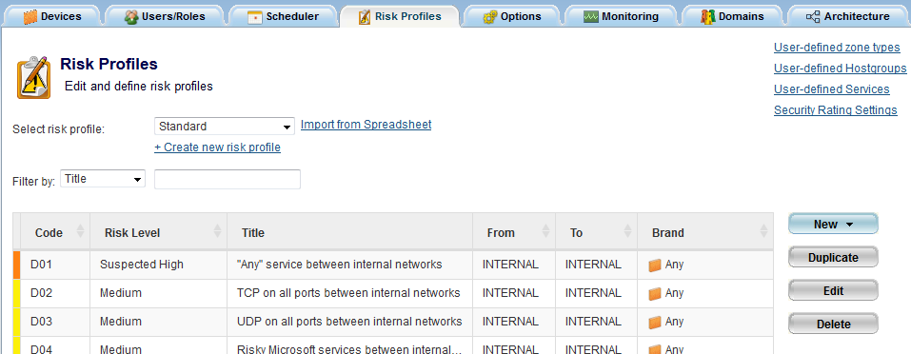
Connectivity Spreadsheet

Slide 38
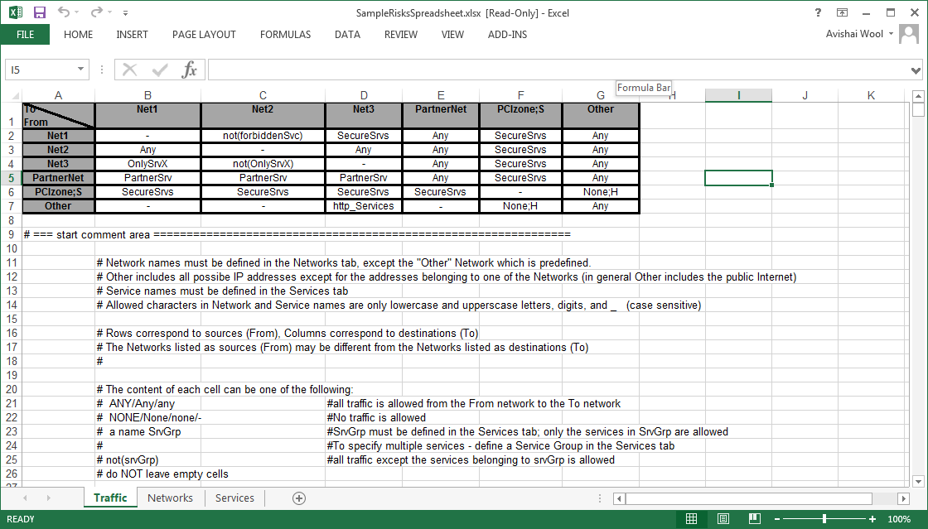

Slide 40
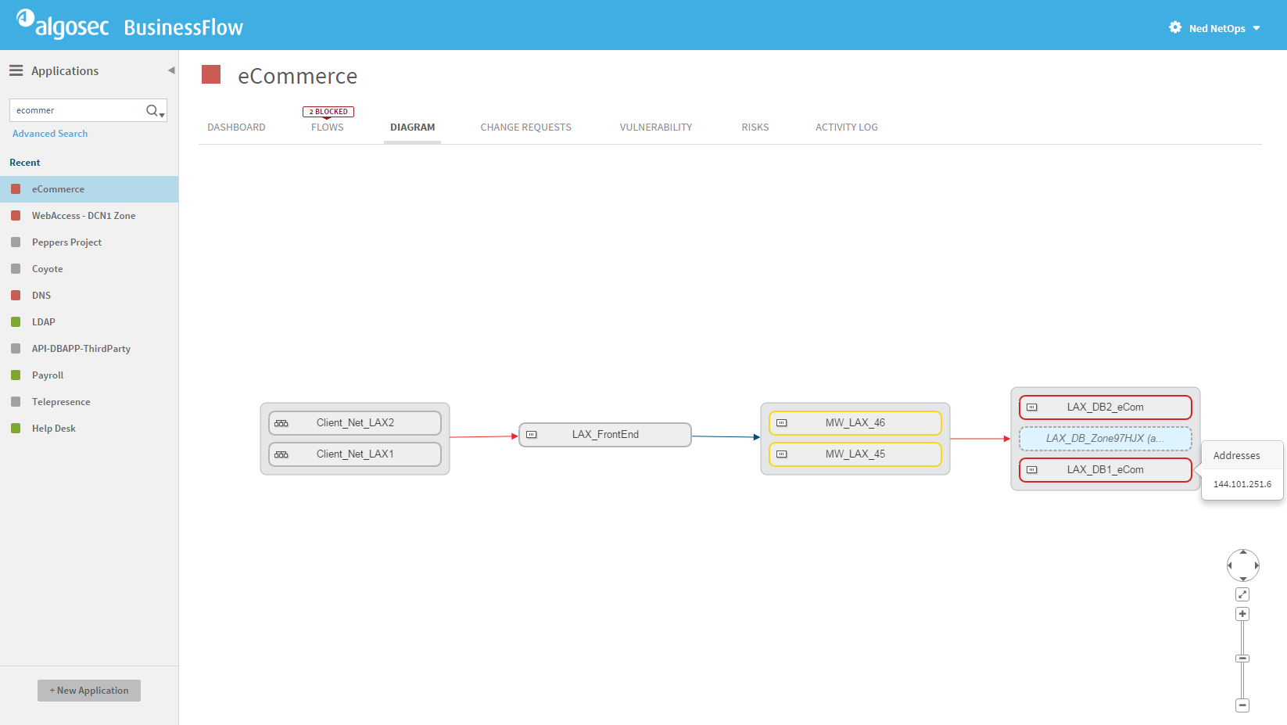
Color Codes indicate vulnerability score

Slide 41
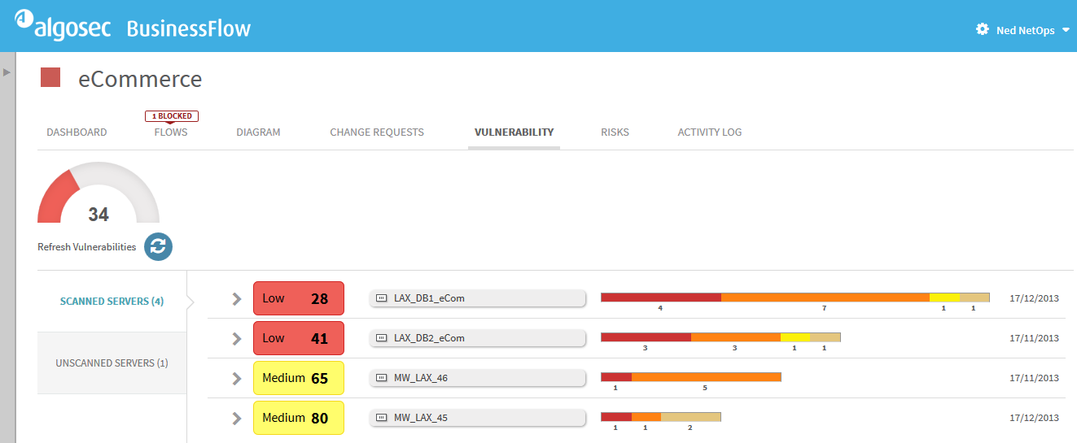
Vulnerabilities at Application Level

Slide 42
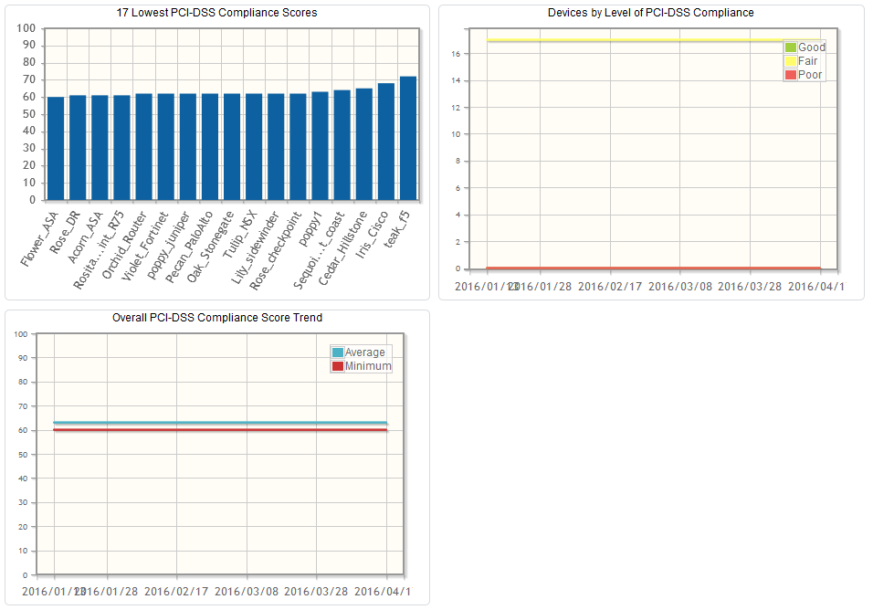
Compliance Dashboard

Slide 43
PCI Compliance for Cloud
Credit-card-processing systems in cloud: same requirements apply … but different technologies are in use
AlgoSec provides same capabilities for cloud, hybrid, private and legacy environments

Slide 44
summary
PCI 3.2 brings extended timeframe for TLS 1.1/1.2 deployment
… and some minor updates to the standard itself
Continuous compliance to instantly generate audit-ready reports
Connectivity and vulnerability reporting per business application
“What-if” risk assessment as part of the change workflow
PCI and the cloud

Slide 45
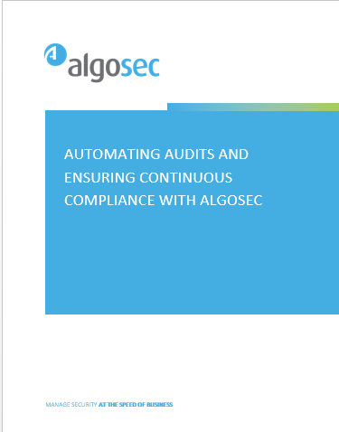
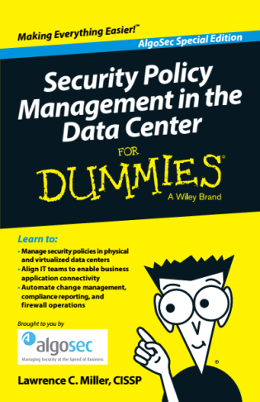
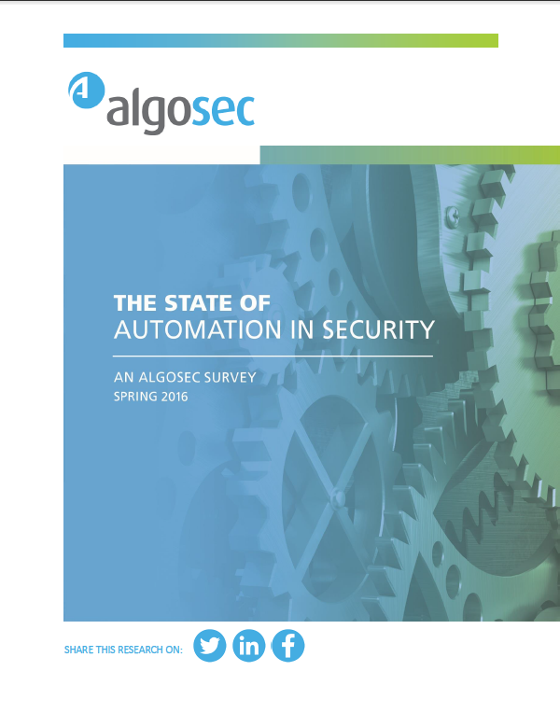
More resources

Slide 46
Thank you

